Slide 1
Two Creations
B. Ricks, PhD
Spring 2021
All images are from CC0 sources.

Slide 2

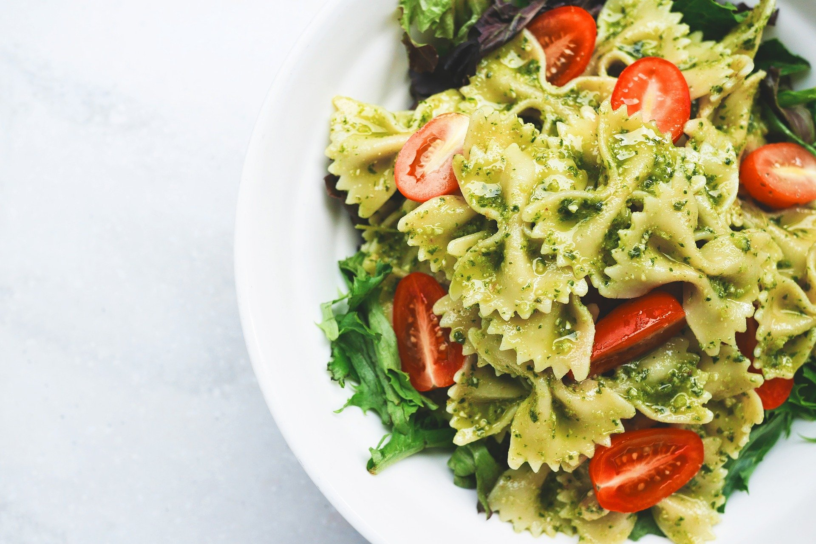
Recipe v. Dish

Slide 3

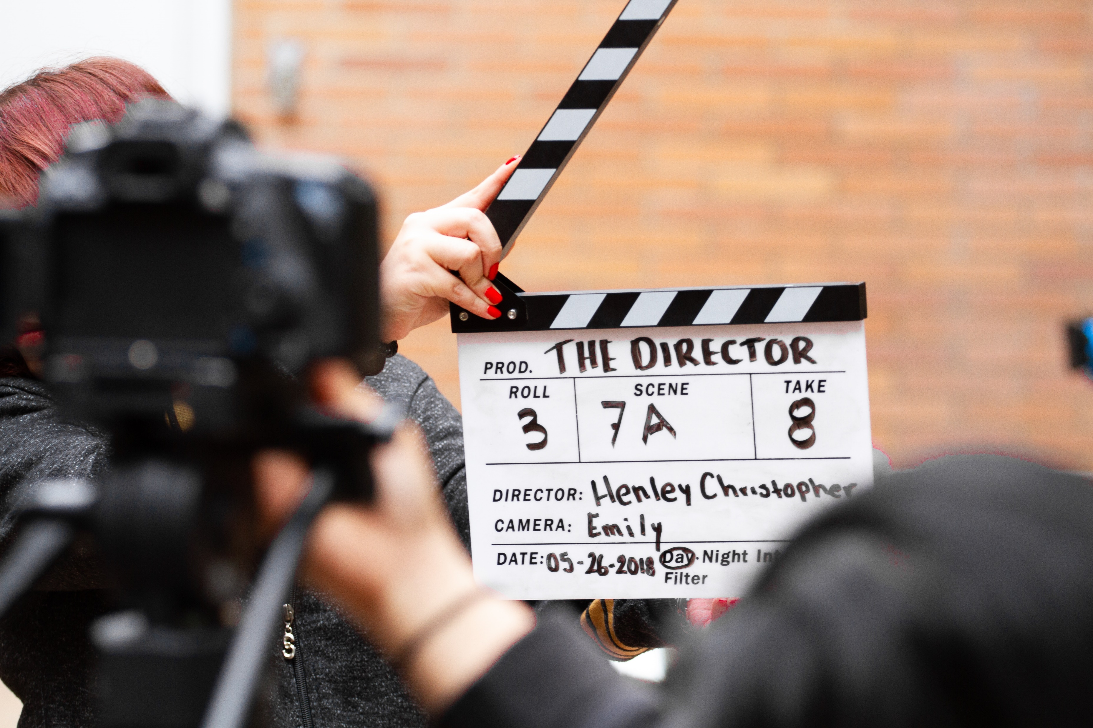
Movie Script v. Movie Shoot

Slide 4
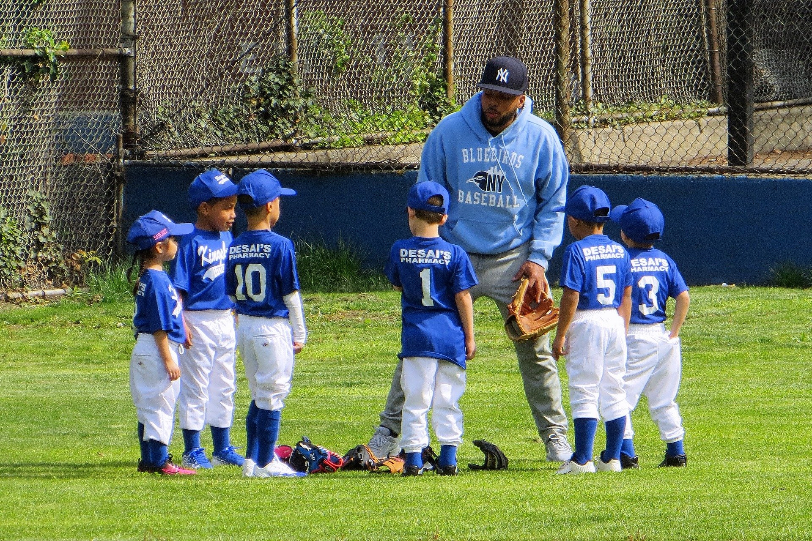
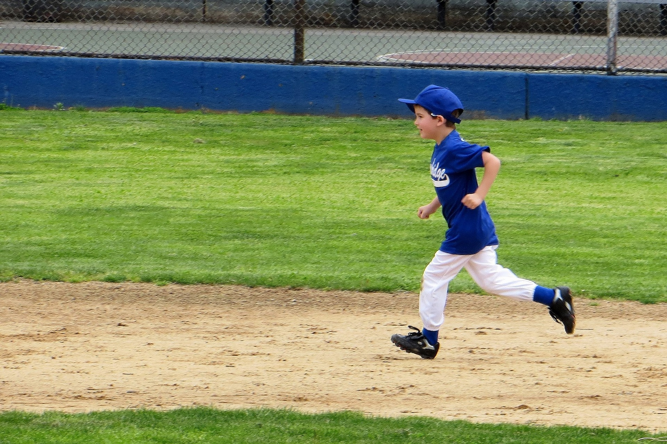
Coach’s Plan v. Teams’ Play

